Slide 2
COST FUNCTION AND LOSS FUNCTION
COST FUNCTION:
Cost function is the difference between actual and predicted value.
It is average of error of n sample in data.
We consider cost function for entire dataset
Example: lot of product will meet guarantee if the weight of lot is 100 kg and our lot weights 98.5 kg. error here will be 100-98.5

Slide 3
Loss function
Loss function is error for individual data point
Loss function is for one training set

Slide 4
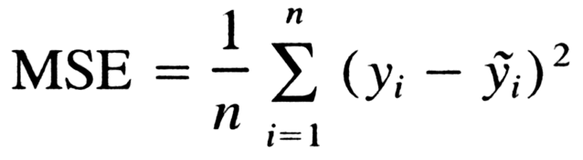
Cost function calculation
Mean square error (L2 loss)

Slide 5

MEAN ABSOLUTE ERROR

Slide 6
GRADIENT DESCENT
Gradient descent is a first-order iterative optimization algorithm for finding a local minimum of a differentiable function.
Gradient descent was invented by French mathematician Louis Augustin Cauchy in 1847.
Through an iterative process, gradient descent refines a set of parameters through use of partial differential equations, or PDEs. It does this to minimize a given cost function to its local minimum.

Slide 7
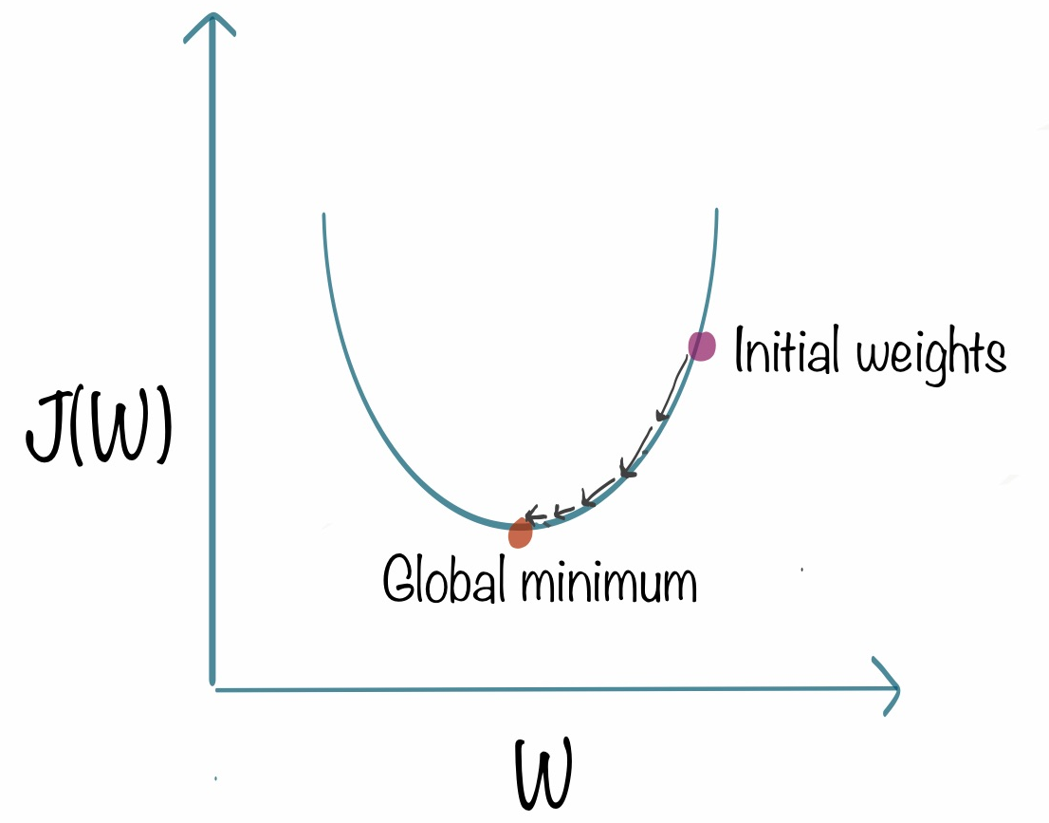

Slide 8
Y=x^2
If x=4 y=16
Take derivative of y with respect to x we get
Y=2*x=8
Xnew=4-0.1*8
Xnew=3.2
Y=10.24
Continue the steps till we get the value of y as 0 to achieve global minima.0.1 is learning rate

Slide 9
Types of gradient function
Batch gradient function
Stocastic gradient function
Mini batch gradient function

Slide 10
BATCH GRADIENT FUNCTION
In Batch Gradient Descent, all the training data is taken into consideration to take a single step. We take the average of the gradients of all the training examples and then use that mean gradient to update our parameters. So that’s just one step of gradient descent in one epoch.

Slide 11
ADVANTAGES
It produces a more stable gradient descent convergence and stable error gradient than stochastic gradient descent. It is computationally efficient as all computer resources are not being used to process a single sample rather are being used for all training samples.

Slide 12
DISADVANTAGES
Sometimes a stable error gradient can lead to a local minima and unlike stochastic gradient descent no noisy steps are there to help get out of the local minima.
The entire training set can be too large to process in the memory due to which additional memory might be needed.

Slide 13
STOCASTIC GRADIENT FUNCTION
SGD randomly picks one data point from the whole data set at each iteration to reduce the computations enormously.
ADVANTAGES: t is easier to fit into memory due to a single training sample being processed by the network.
It is computationally fast as only one sample is processed at a time.
For larger datasets it can converge faster as it causes updates to the parameters more frequently.

Slide 14
DISADVANTAGES
Due to frequent updates the steps taken towards the minima are very noisy. ...
Also, due to noisy steps it may take longer to achieve convergence to the minima of the loss function.

Slide 15
MINI BATCH GRADIENT FUNCTION
Mini-batch gradient descent is a variation of the gradient descent algorithm that splits the training dataset into small batches that are used to calculate model error and update model coefficients.
Implementations may choose to sum the gradient over the mini-batch which further reduces the variance of the gradient.
Mini-batch gradient descent seeks to find a balance between the robustness of stochastic gradient descent and the efficiency of batch gradient descent. It is the most common implementation of gradient descent used in the field of deep learning.

Slide 16
ADVANTAGES
Easily fits in the memory.
It is computationally efficient.
Benefit from vectorization.
If stuck in local minimums, some noisy steps can lead the way out of them.
Average of the training samples produces stable error gradients and convergence.

Slide 17
DISADVANTAGES
Sometimes a stable error gradient can lead to a local minima and unlike stochastic gradient descent no noisy steps are there to help get out of the local minima.
The entire training set can be too large to process in the memory due to which additional memory might be needed.

